Slide 1
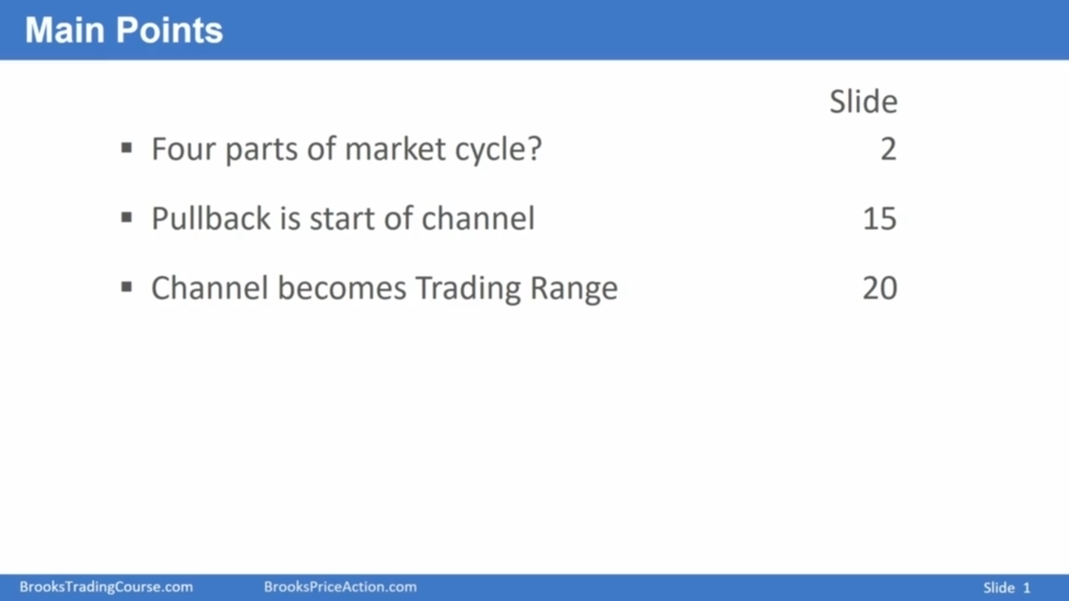
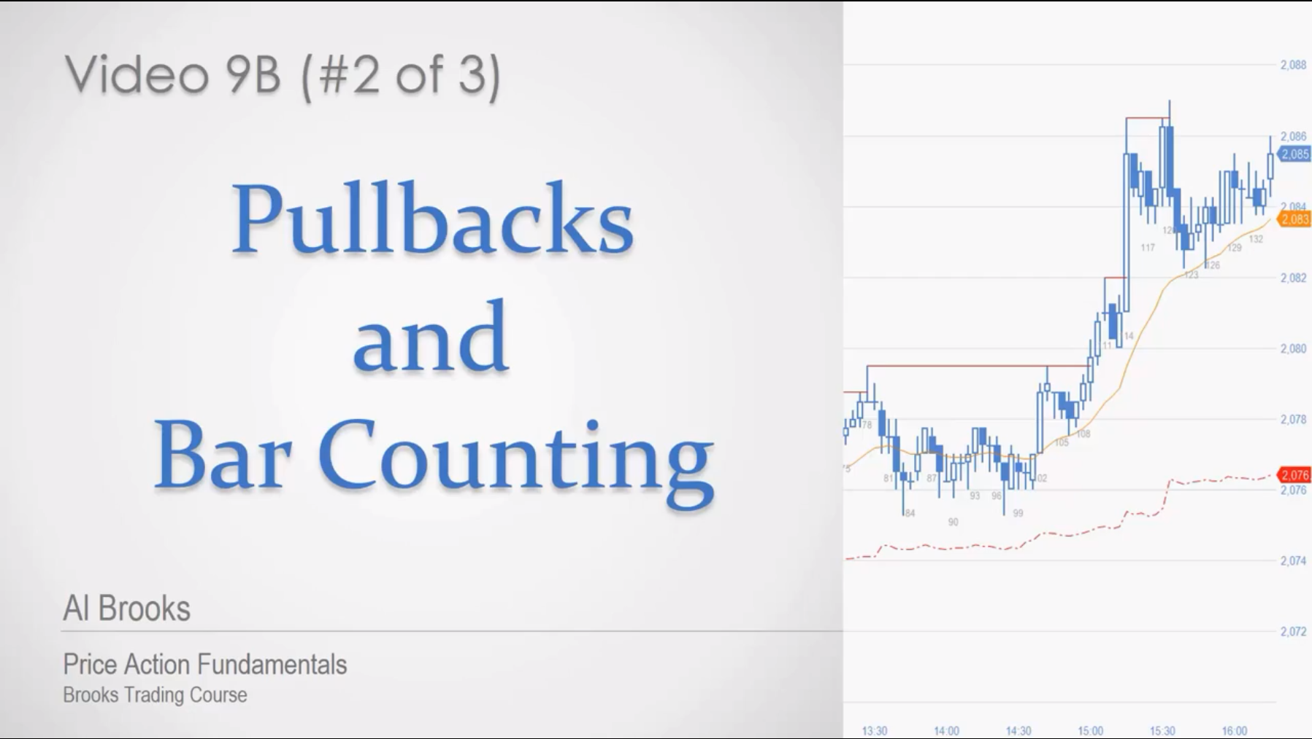

Slide 2
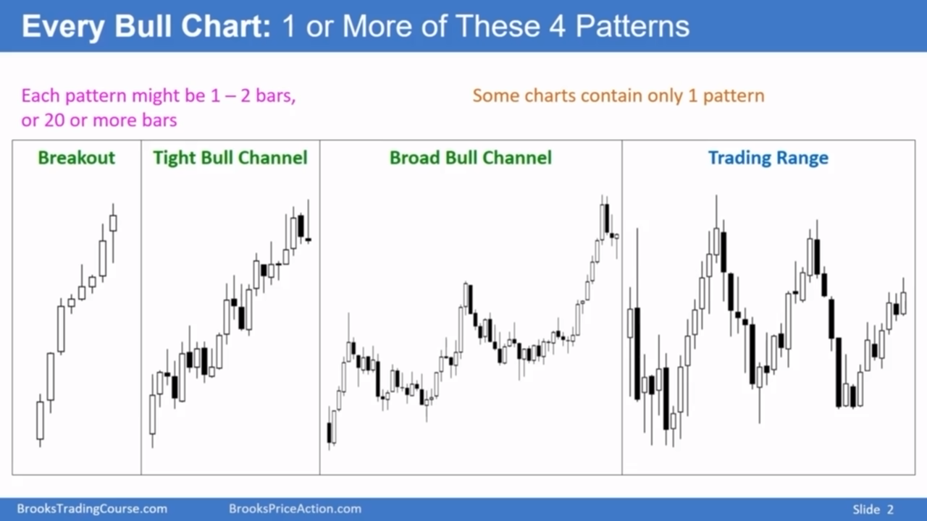
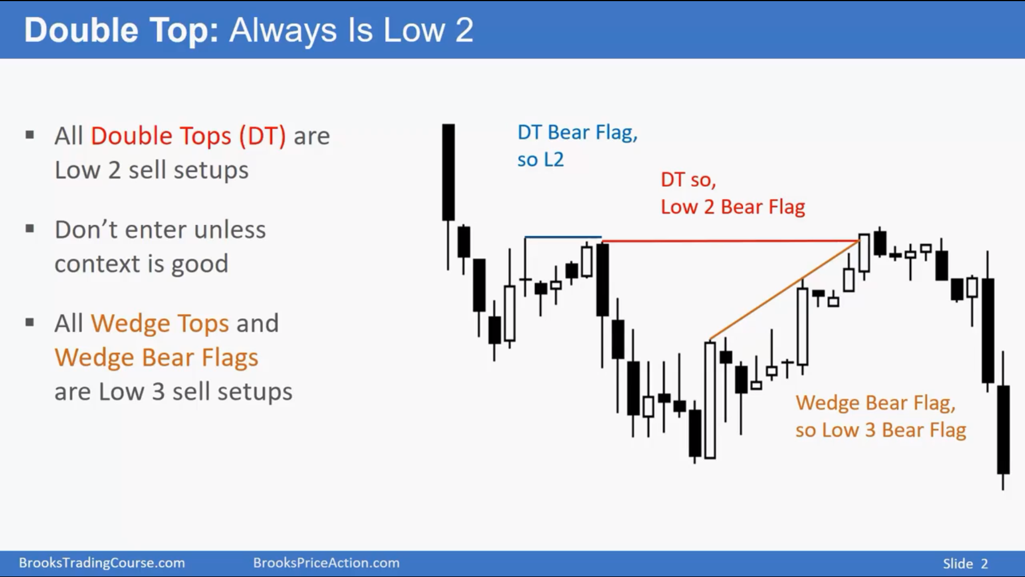
Notes:
Breakout：连续阳线，没有重叠
Tight Bull Channel:
Broad Bull Channel：
Ttading Range：

Slide 3
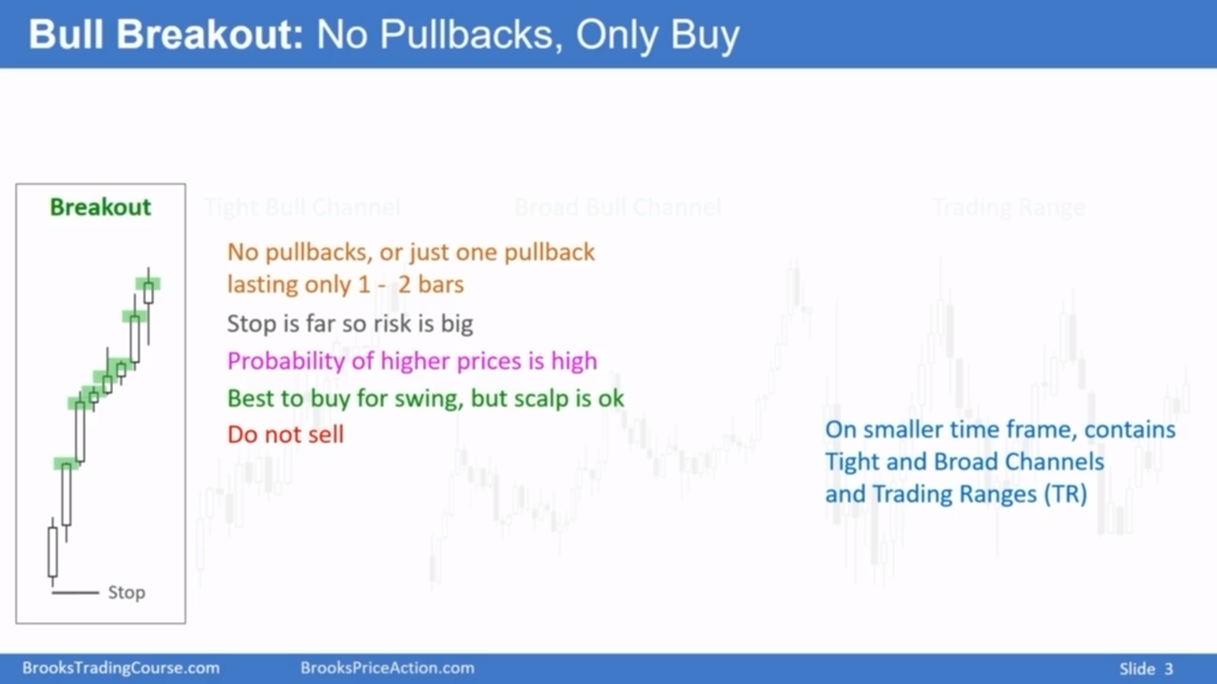

Slide 4
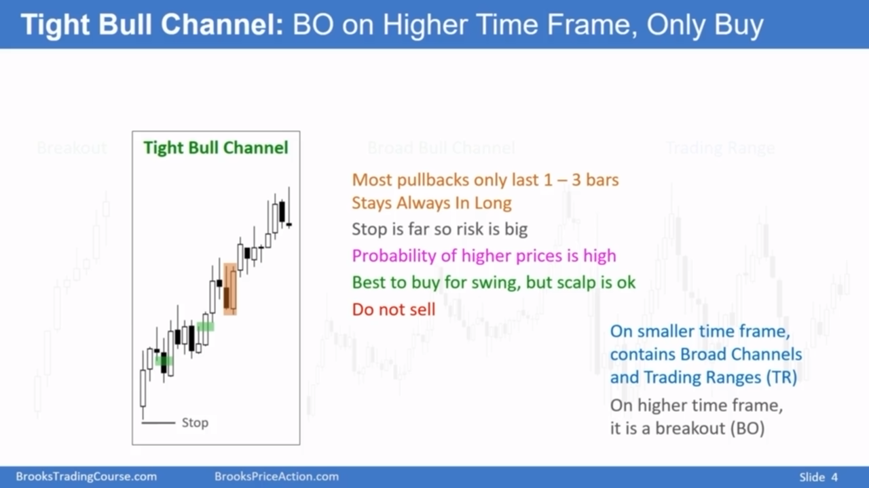

Slide 5
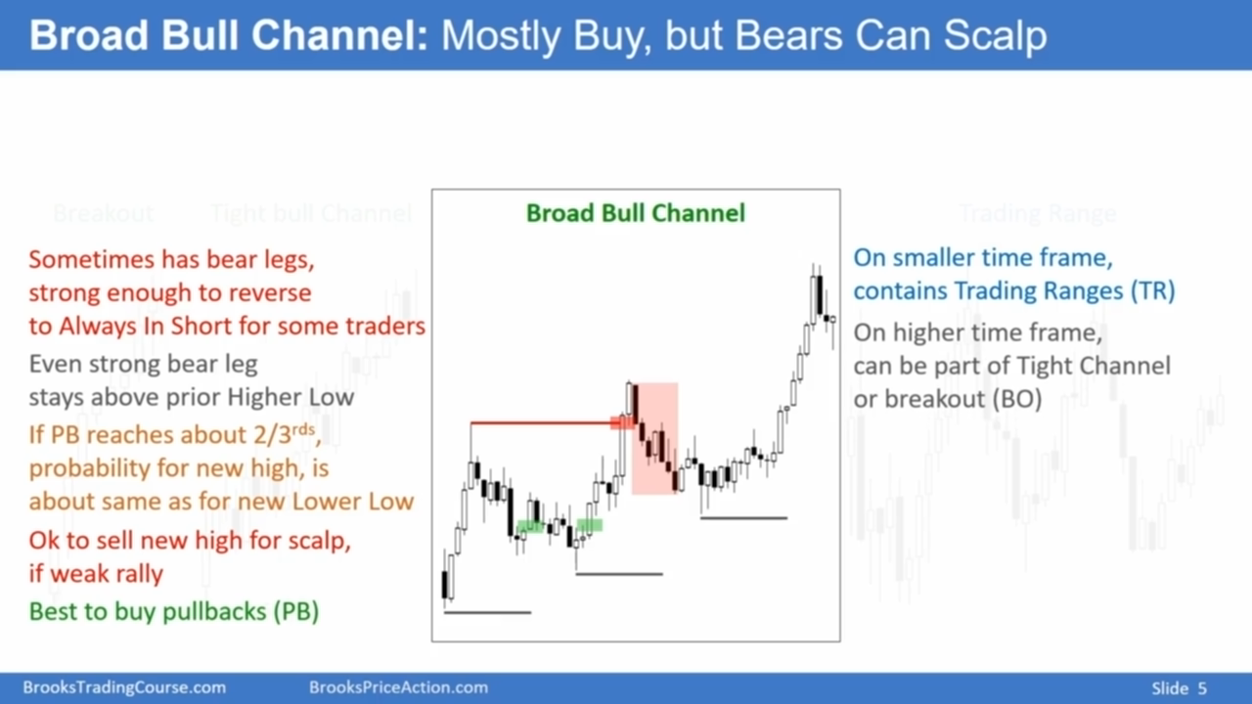

Slide 6
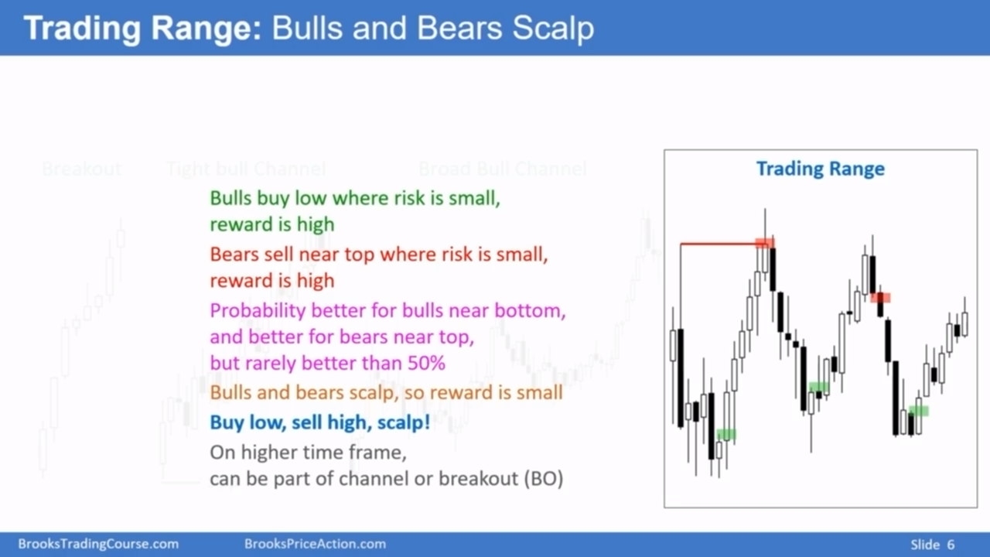
Notes:
And a trading range is a market that has 20 or more bars, and the probability of a bull breakout falls to about the same as a bear breakout.
Well, a trading range is basically a broad channel that's flat, horizontal, and traders trade it the same way.
In the trading range, 80% of breakout attempts fail.

Slide 7
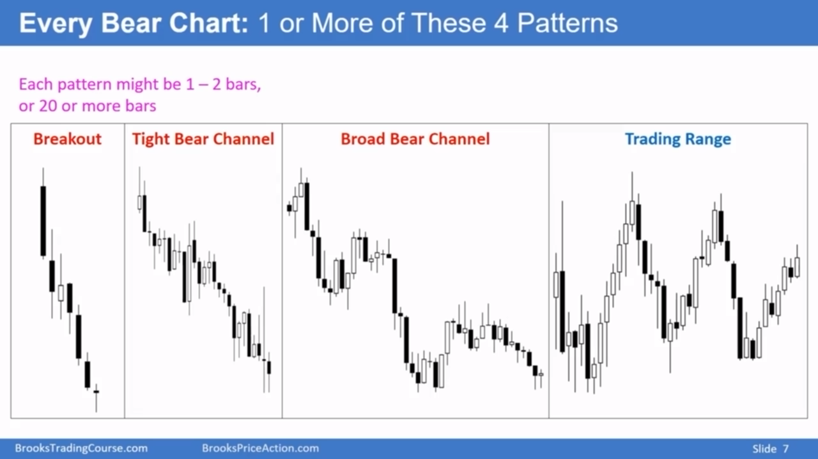

Slide 8
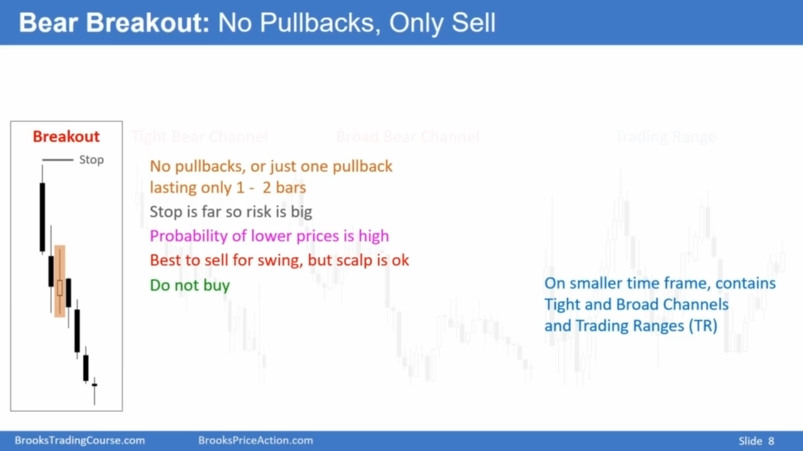

Slide 9
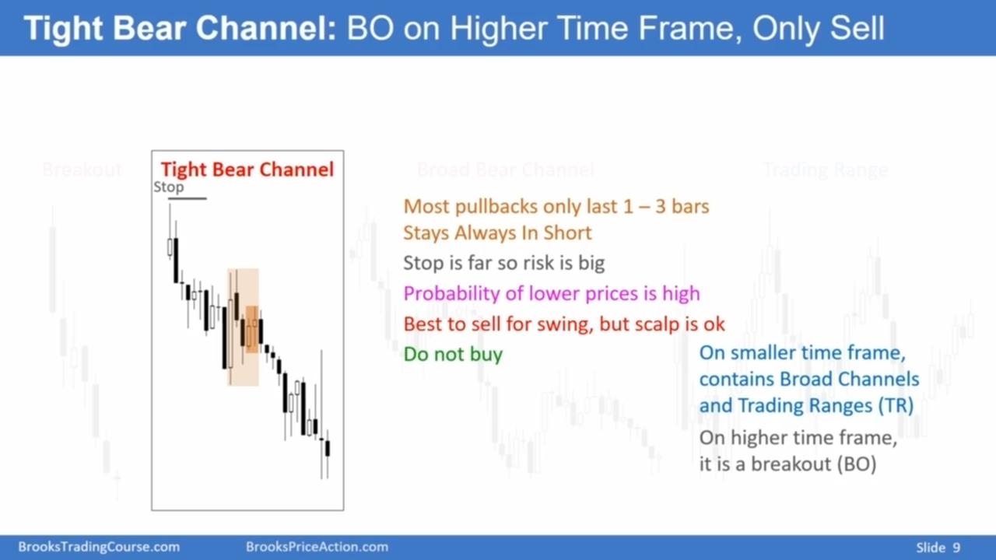

Slide 10
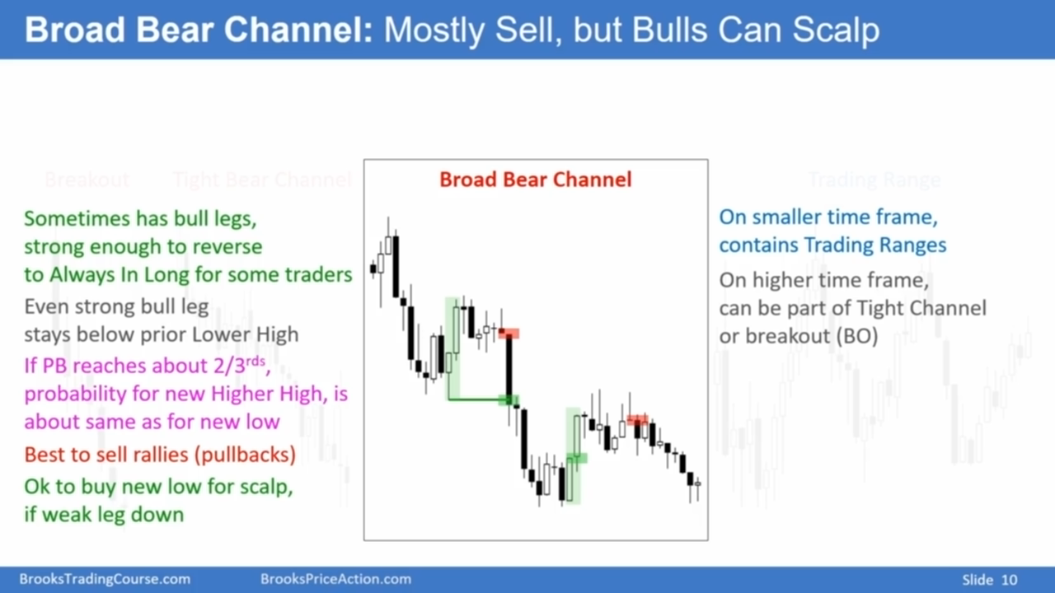

Slide 11
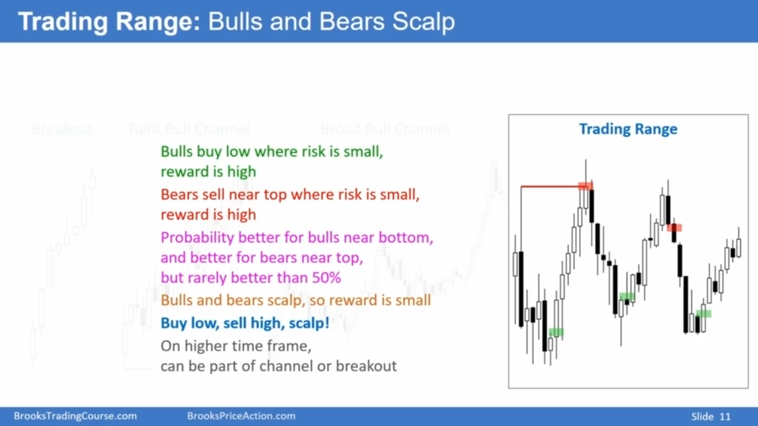

Slide 12
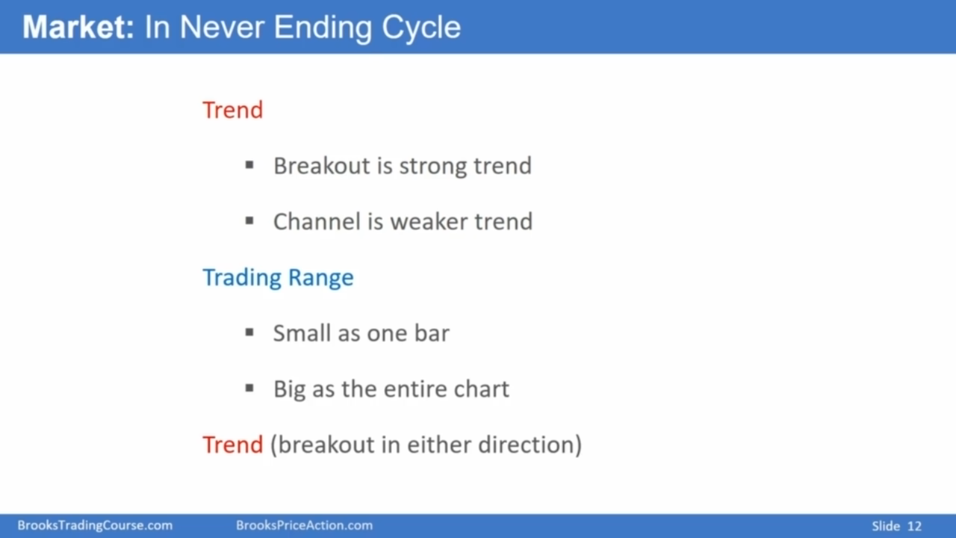
Notes:
Once a trading range reaches 20 bars or more, the probability of a bull breakout is about the same as for a bear breakout.

Slide 13
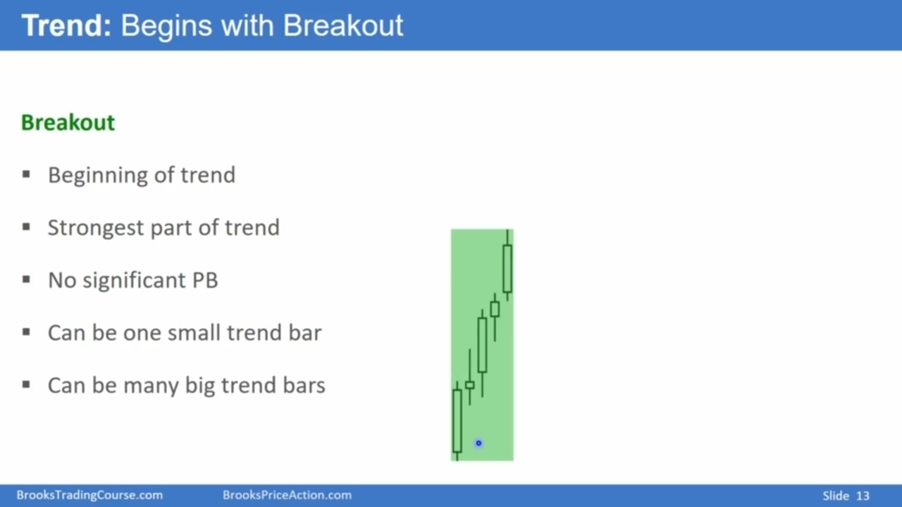

Slide 14
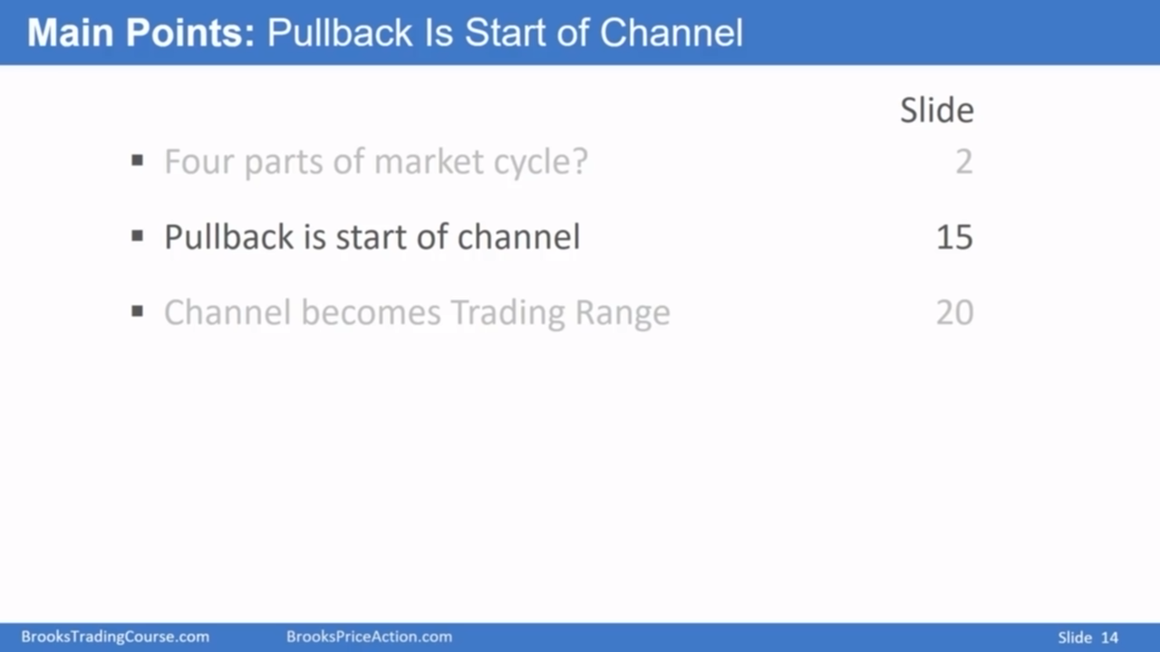
Notes:
Pullback in a bull trend means the low of the bar goes below the low of a prior bar.

Slide 15
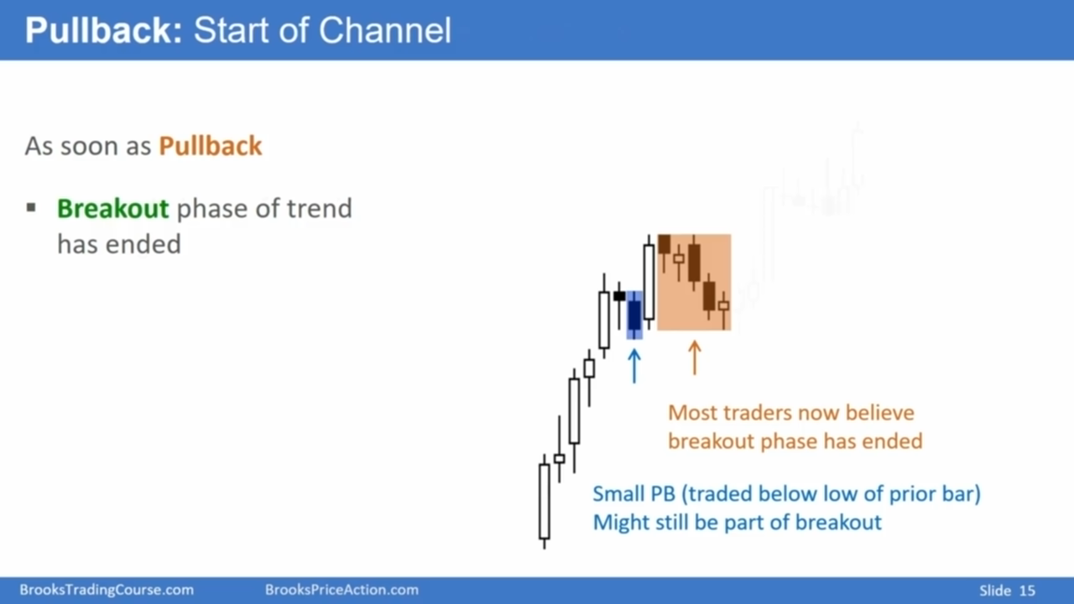

Slide 16
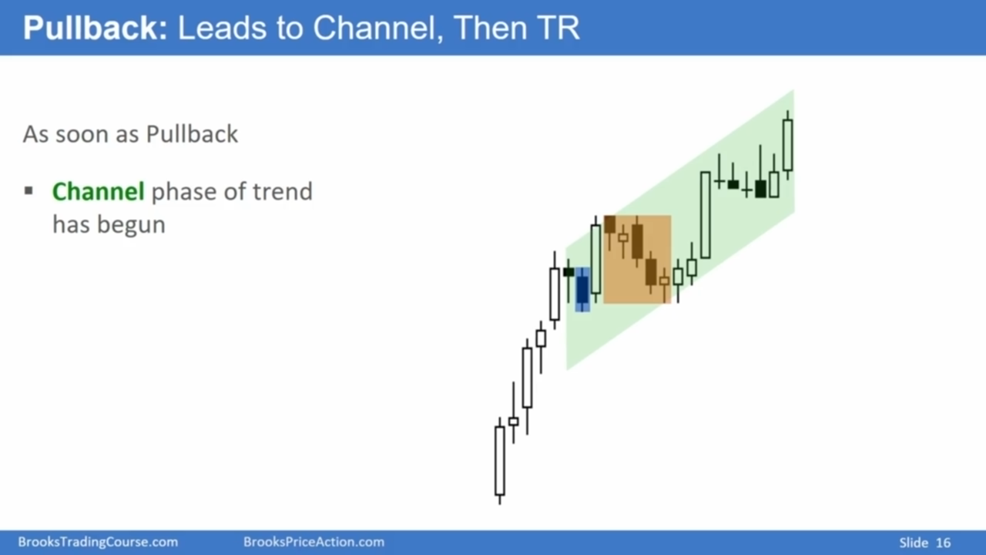

Slide 17
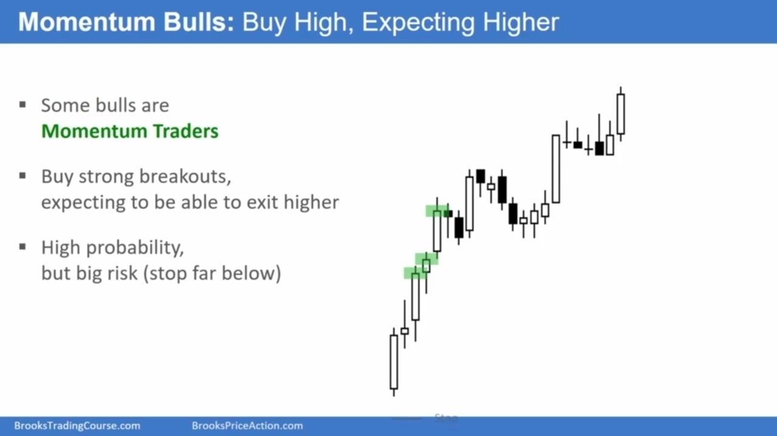

Slide 18
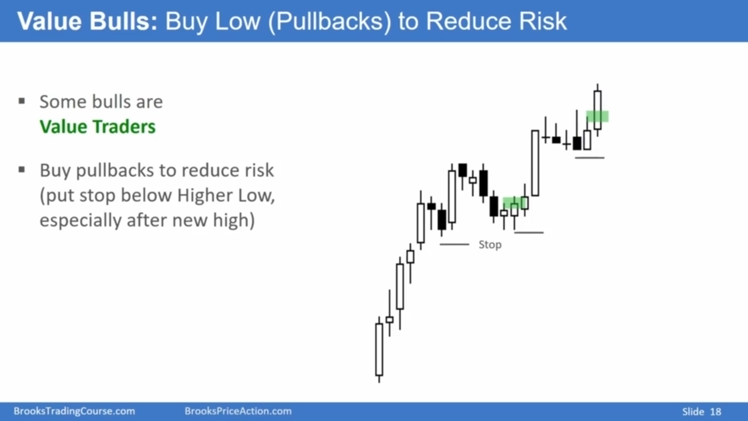

Slide 19
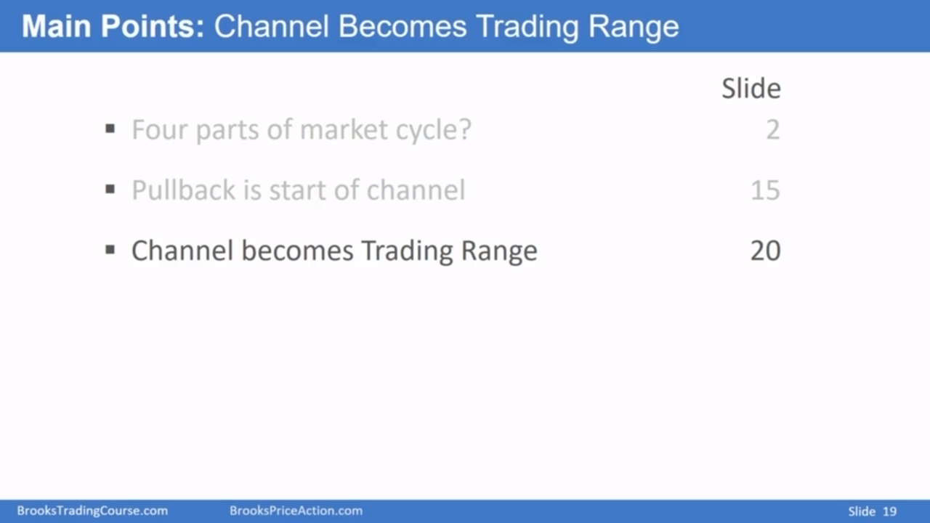
Notes:
Rarely a bull channel will have another bull breakout and an even stronger bull trend, but at least 75% of bull channels have bear breakouts.

Slide 20
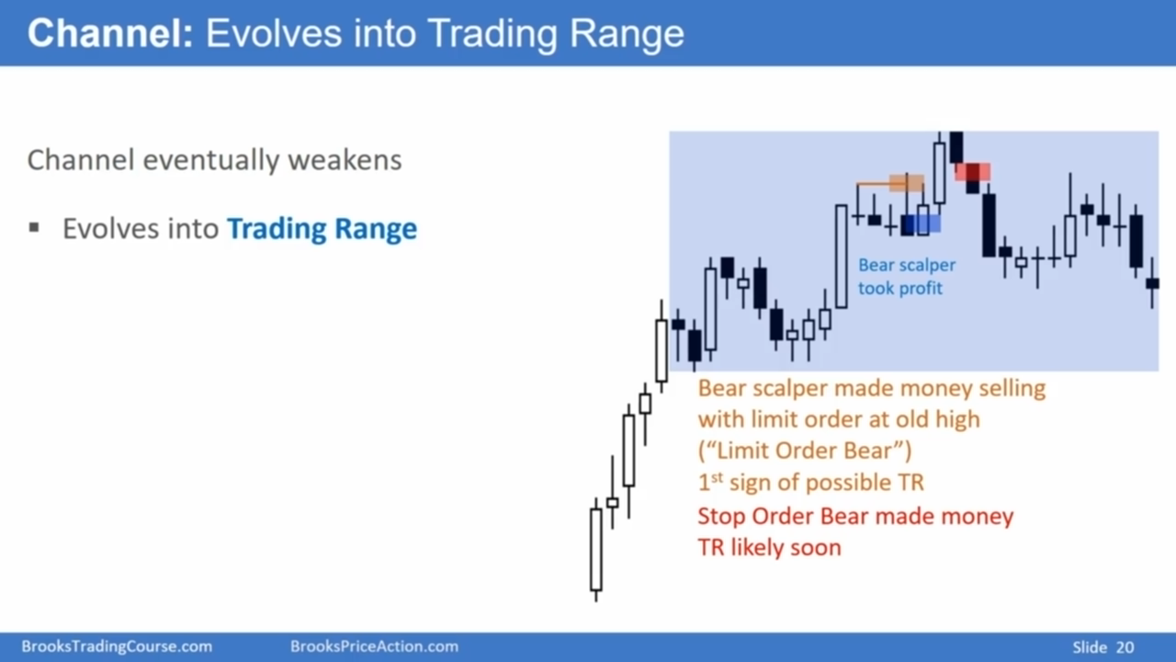
Notes:
One of the things I pay attention to is can the bears make money? That's really important. How easy is it for the bears to make money? Can the bears make money here?
No, really difficult. Here, really difficult. But look right here. If a bear sells at the prior high, he could scalp here.
And then the stop order bears, once I see stop order bears making money, then we're probably in the early phases of a trading range.

Slide 21
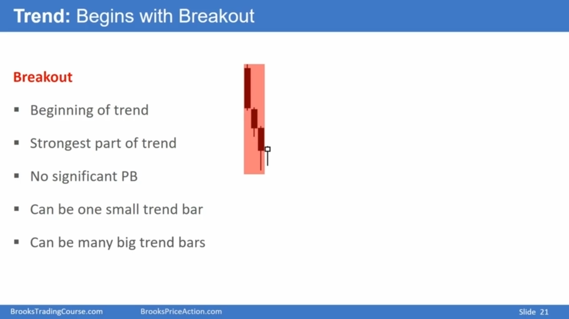

Slide 22
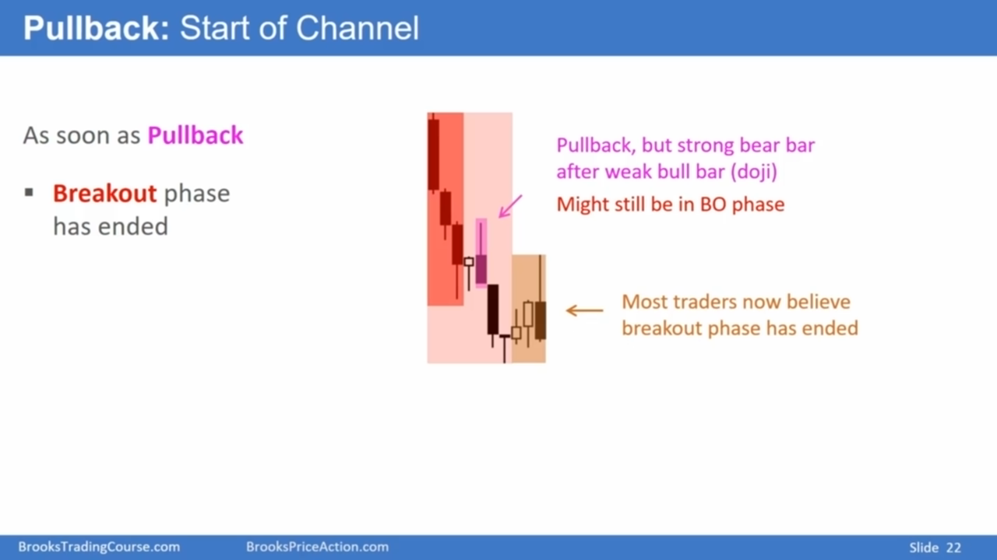

Slide 23
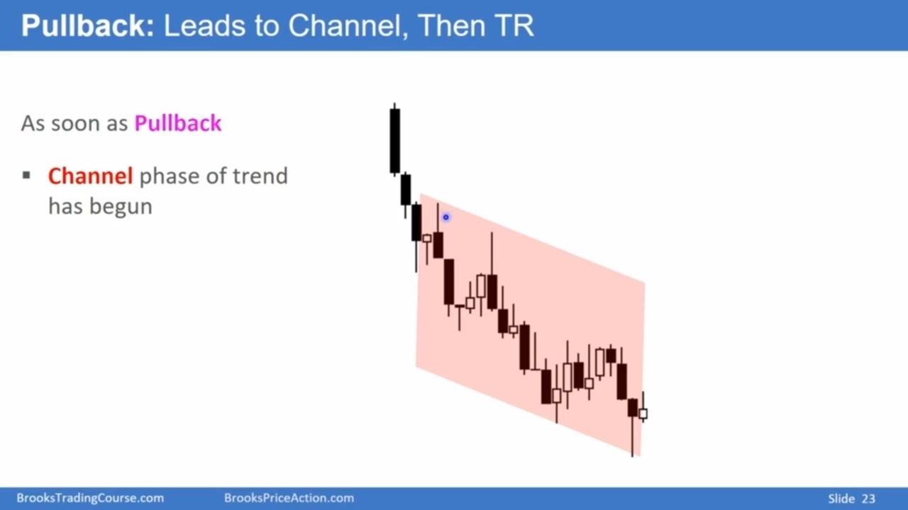

Slide 24
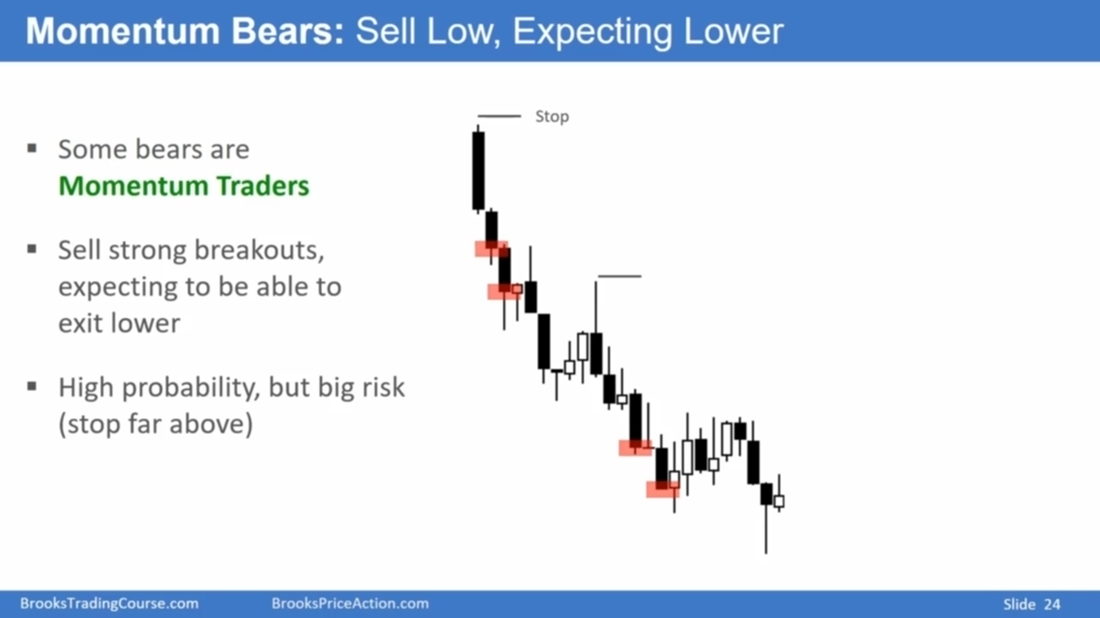

Slide 25
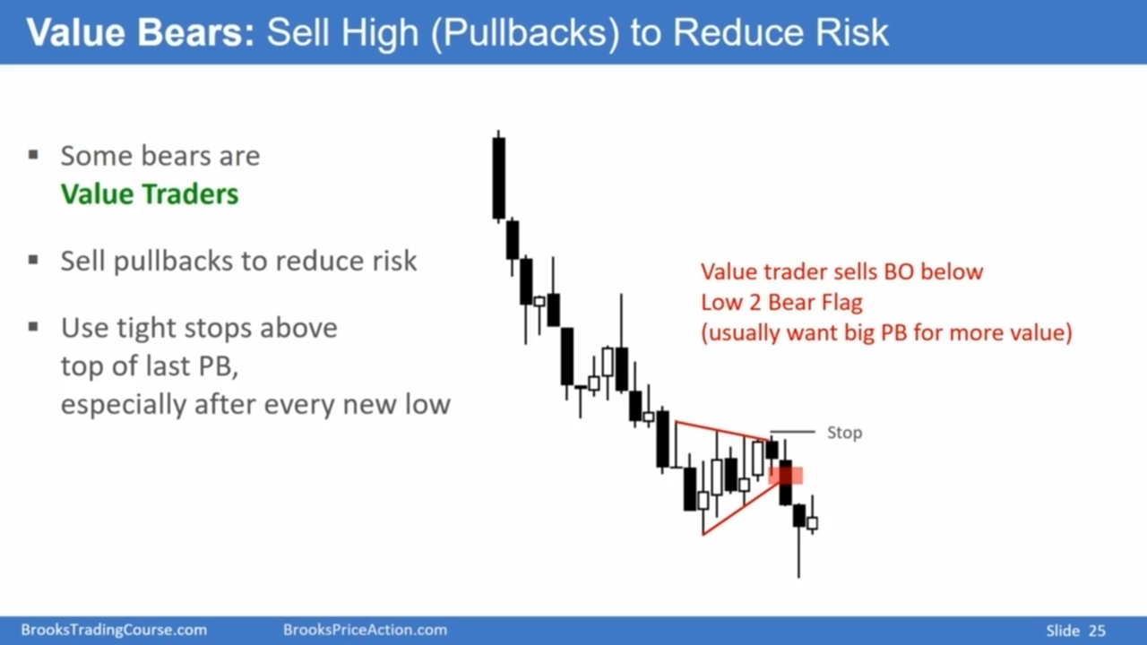

Slide 26
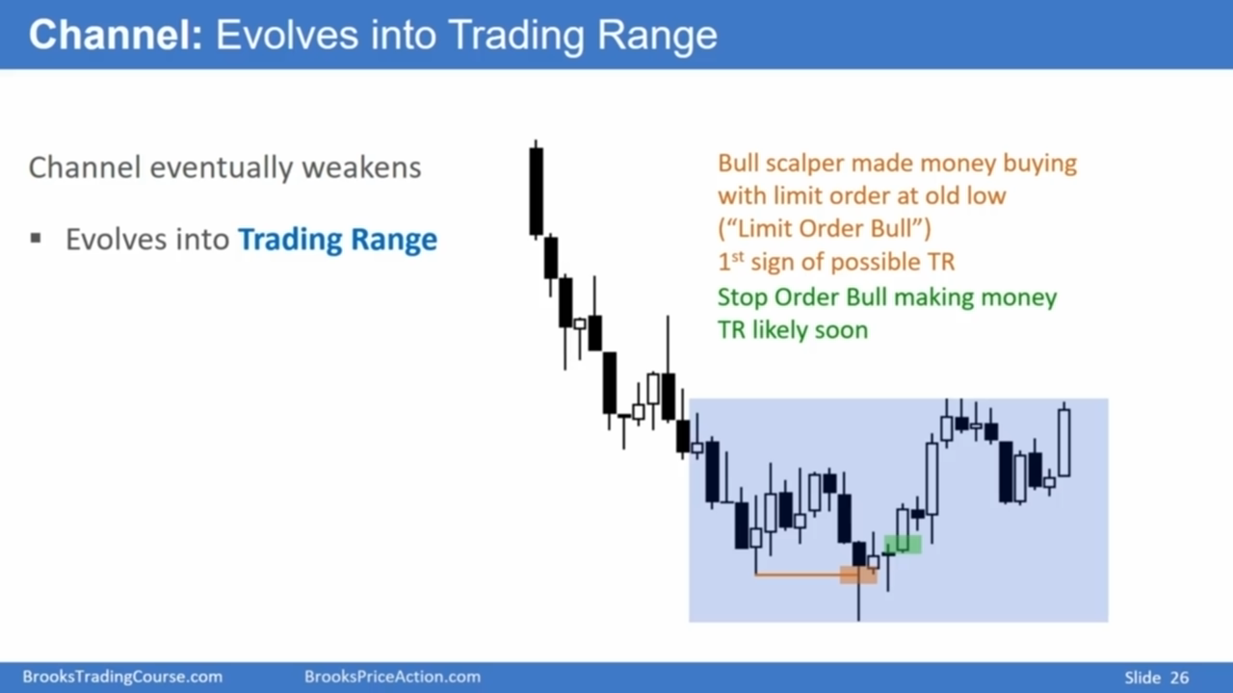

Slide 27
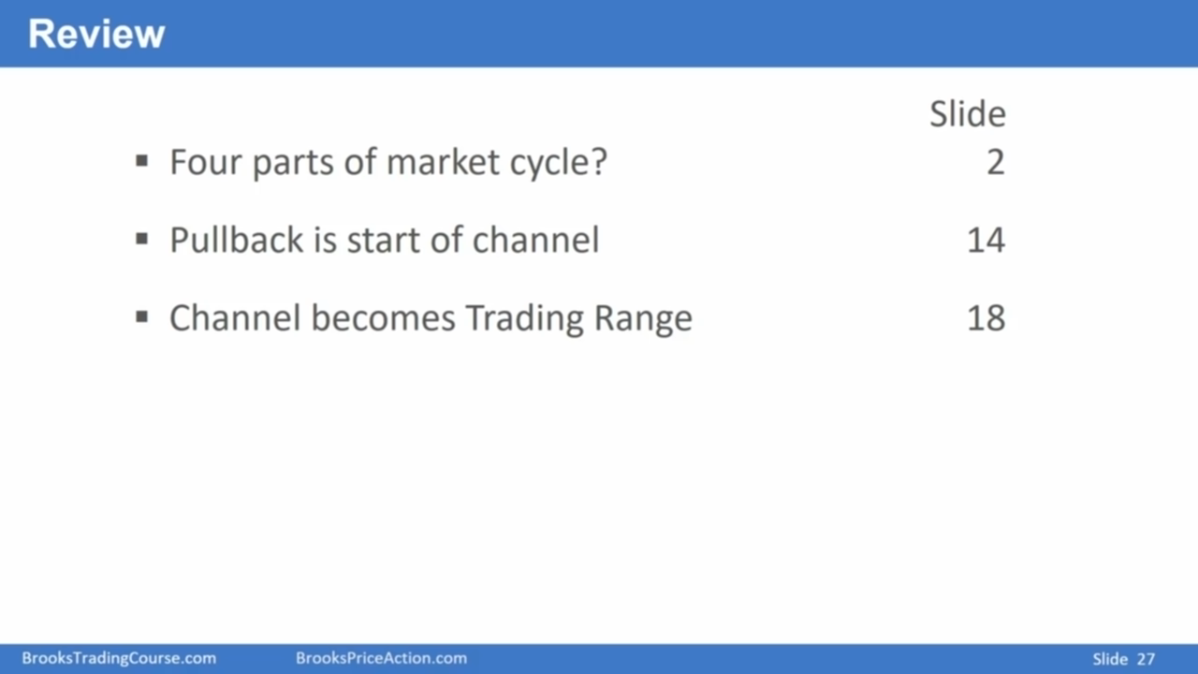
As soon as there's a pullback, the breakout has ended and now the market's in a channel.
And eventually a channel evolves into a trading range.
And then after the market's been in a trading range for a while, it breaks out and the breakout has about the same probability of going up or down.
If the channel is tight, again, trade it like a breakout only sell if it's a bear channel.
If the channel is fairly broad, you can trade in both directions.

Slide 28
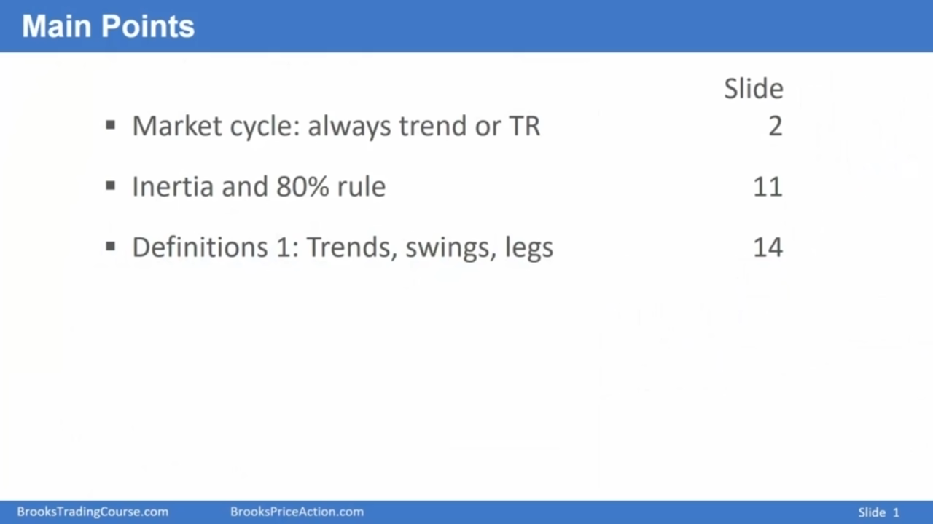
When I'm trading, I always think of every chart as either being in a trend or in a trading
For that matter, I think of every bar as either being a trend bar or a trading range bar.

Slide 29
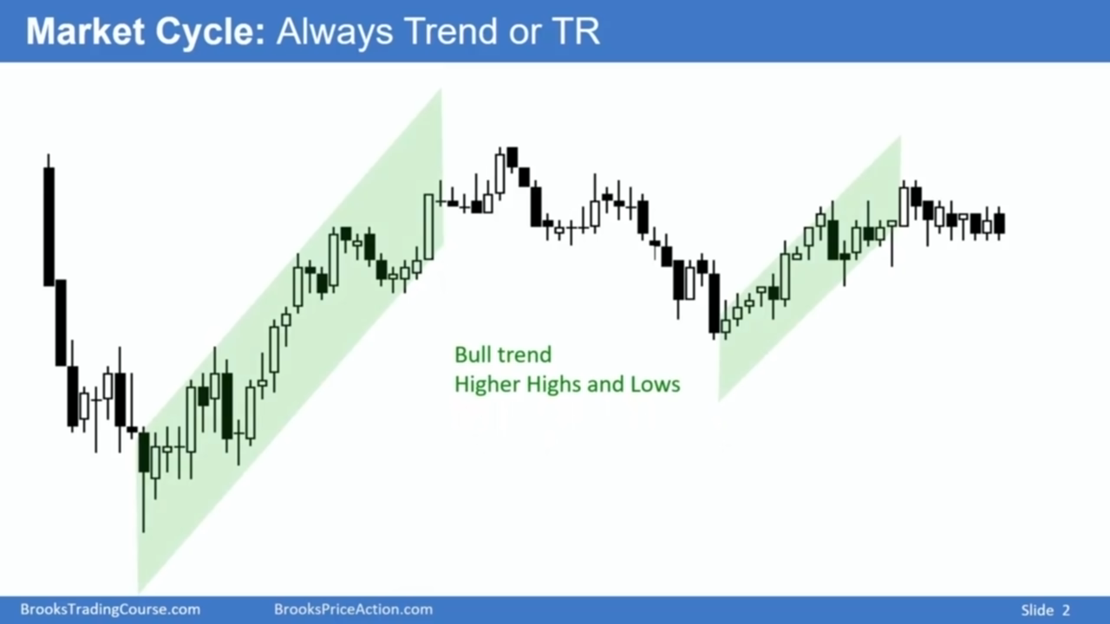

Slide 30
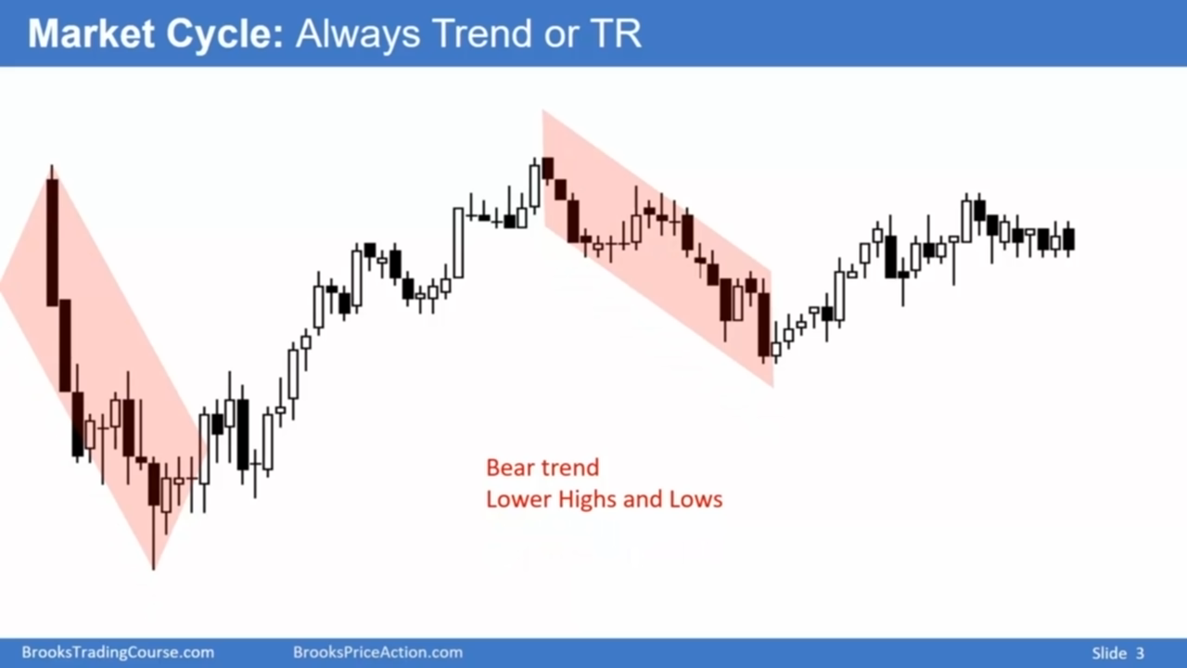

Slide 31
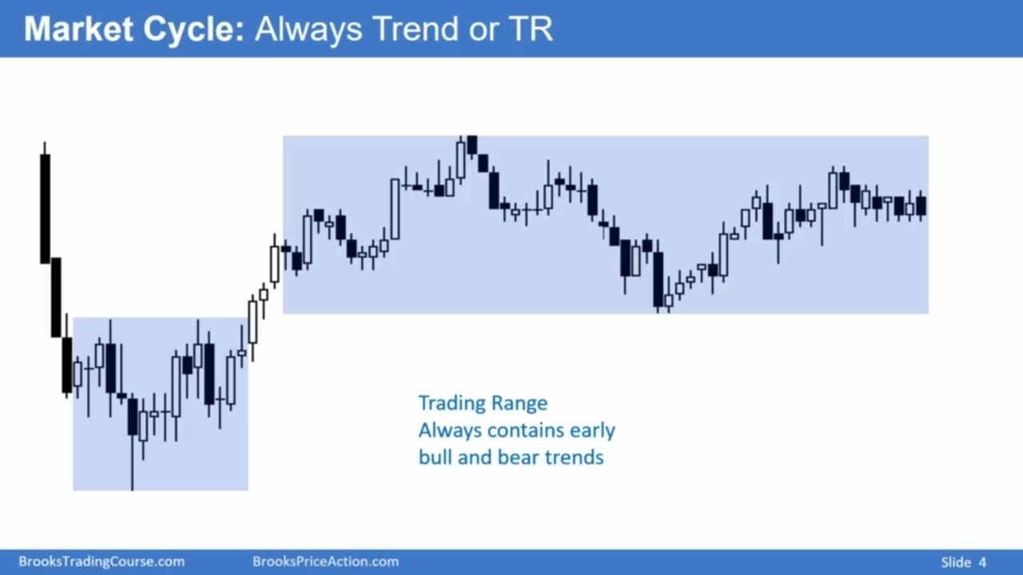

Slide 32
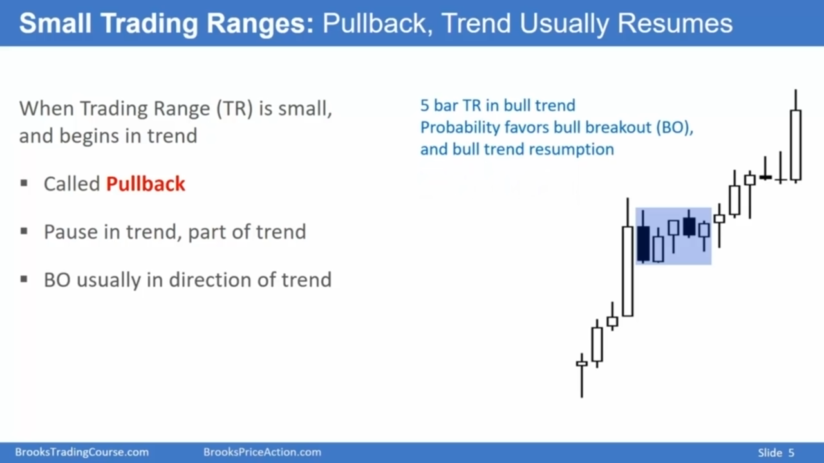

Slide 33
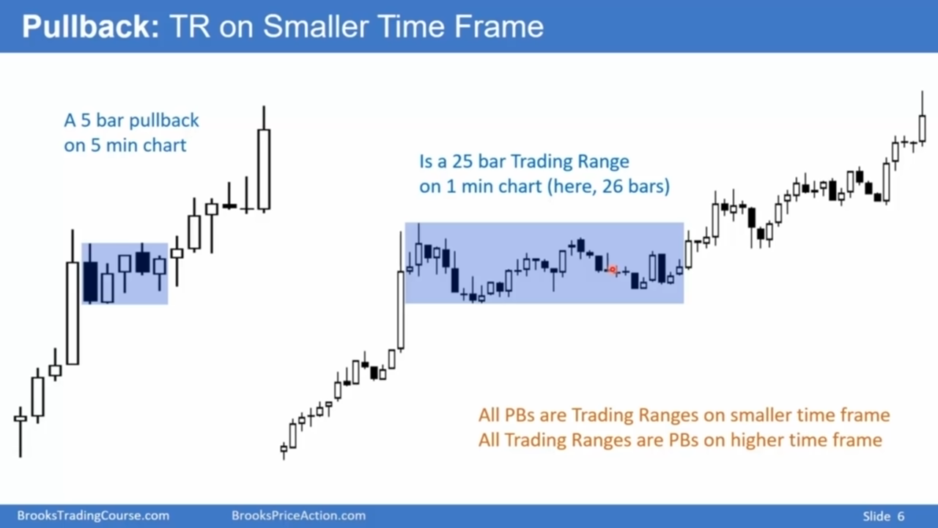

Slide 34
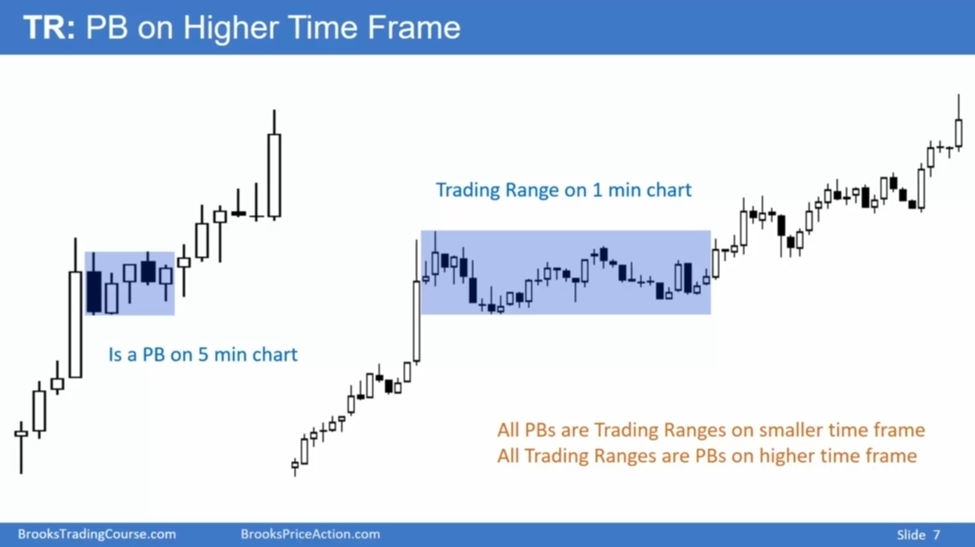
Notes:
So all pullbacks are trading ranges on smaller time frames and all trading ranges are pullbacks on higher time frames.

Slide 35
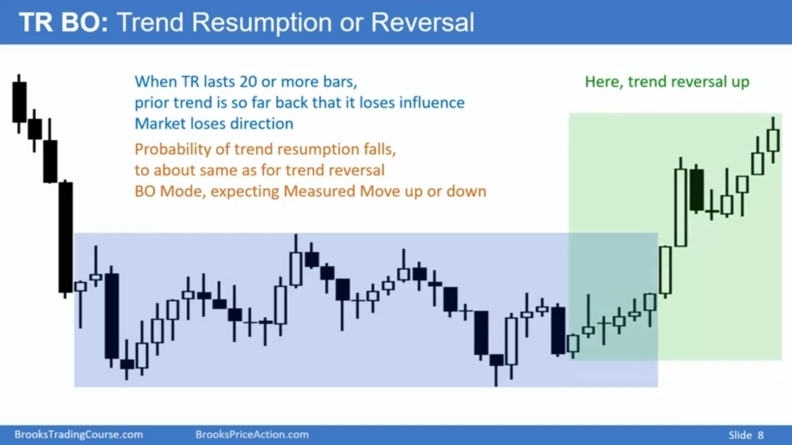

Slide 36
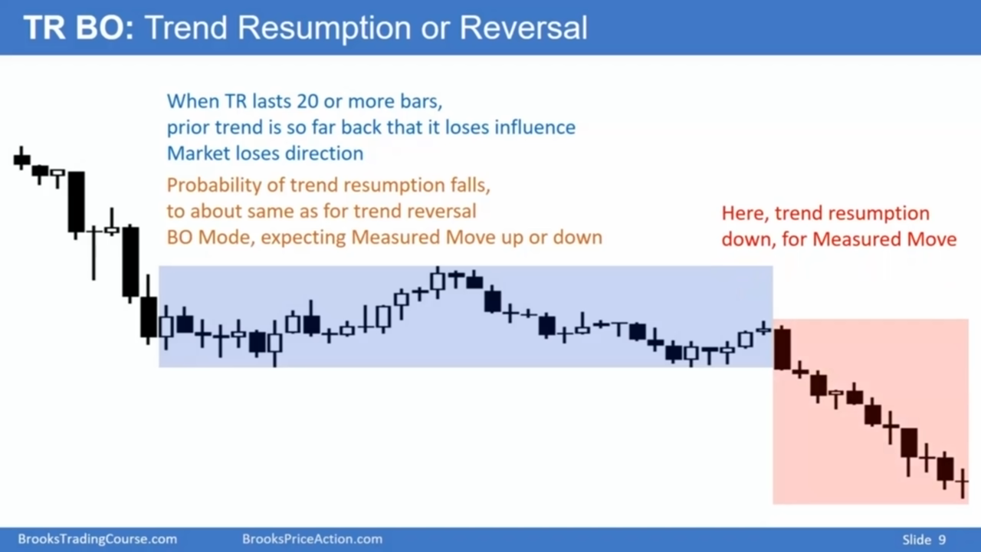

Slide 37
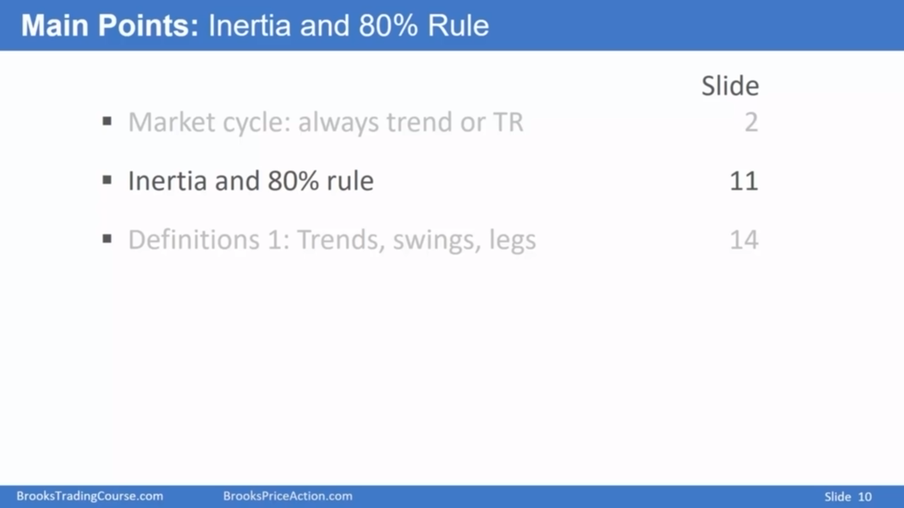
Inertia means that an object tends to continue what it has been doing.
And markets tend to continue what they've been doing.

Slide 38
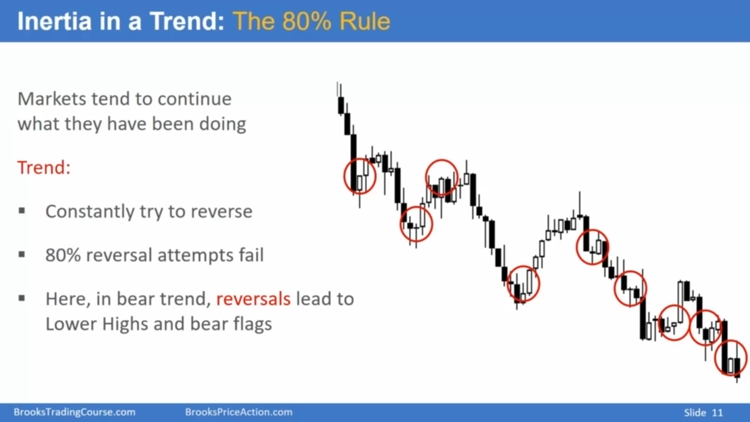

Slide 39
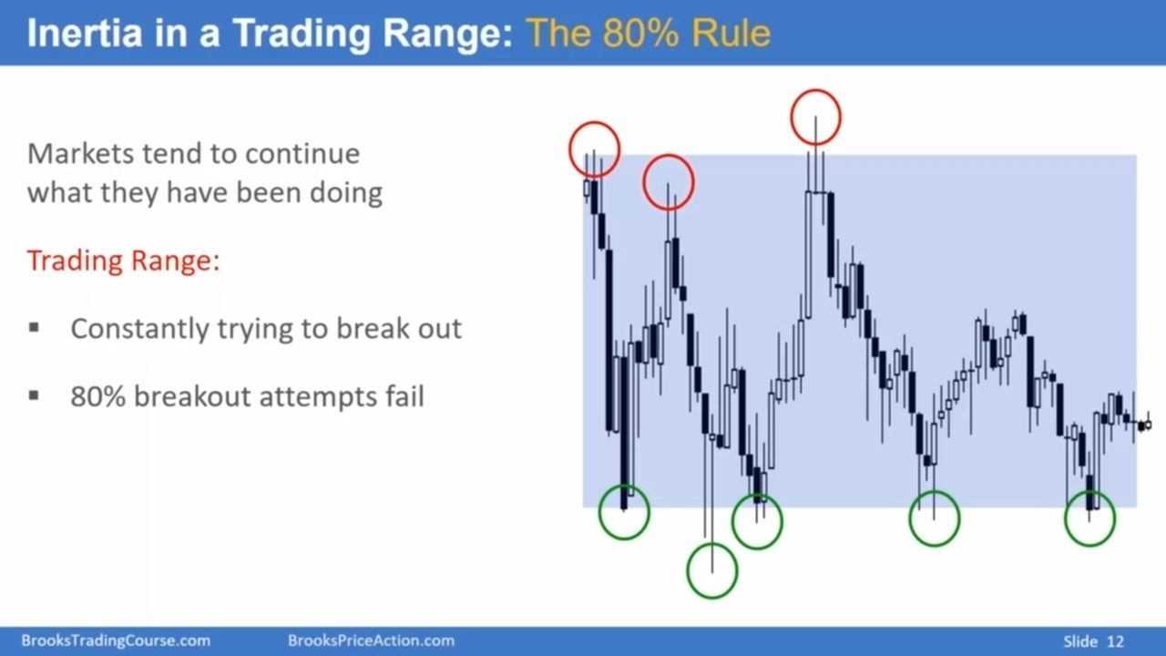

Slide 40
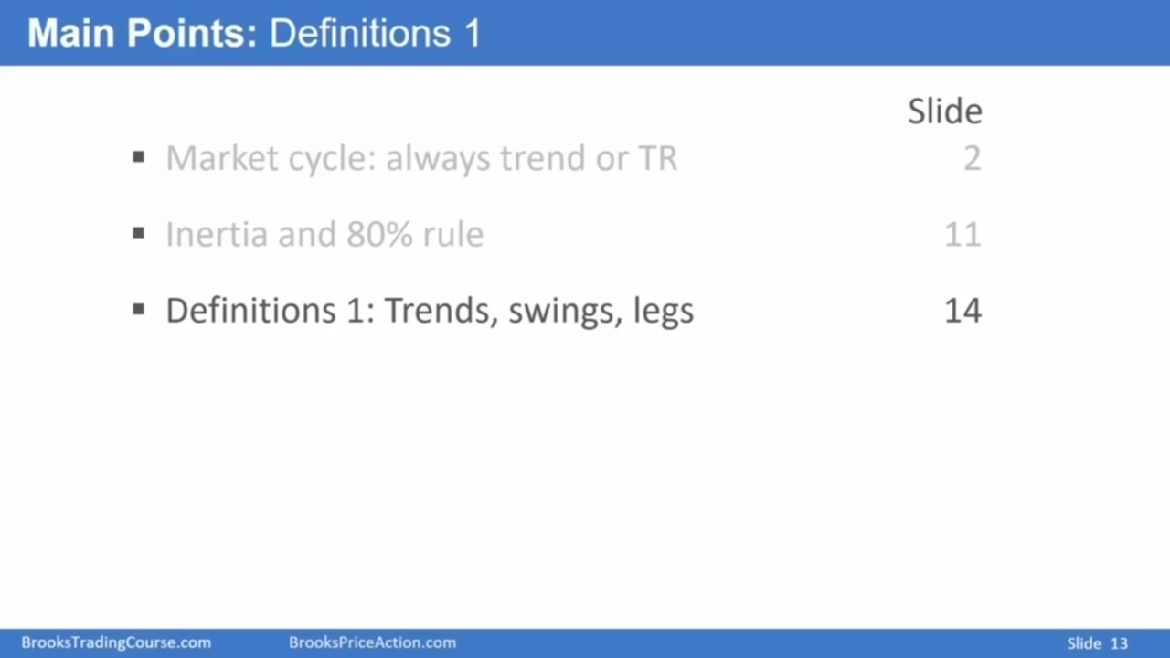

Slide 41
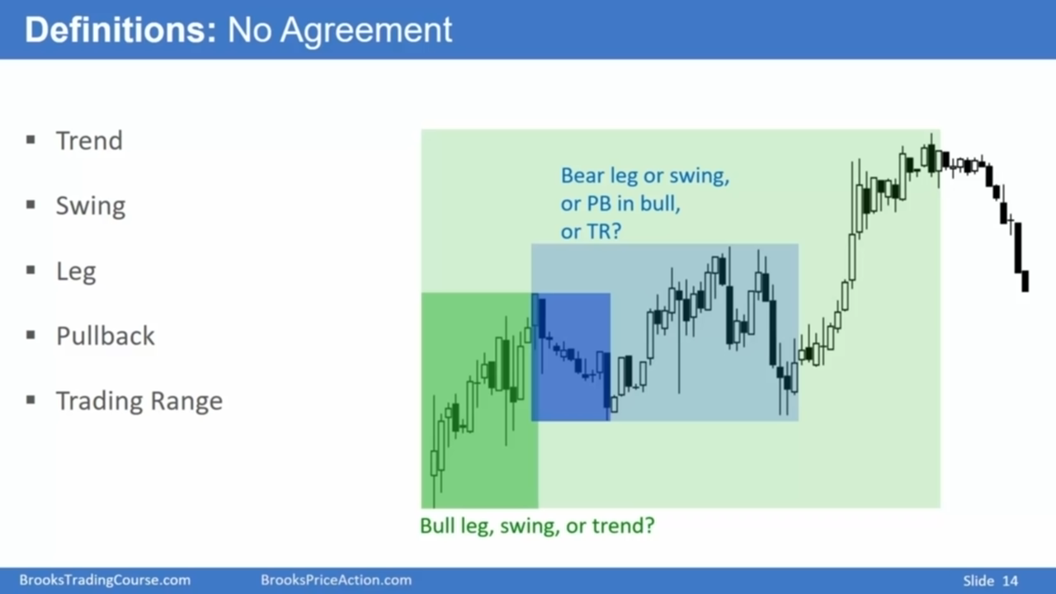

Slide 42
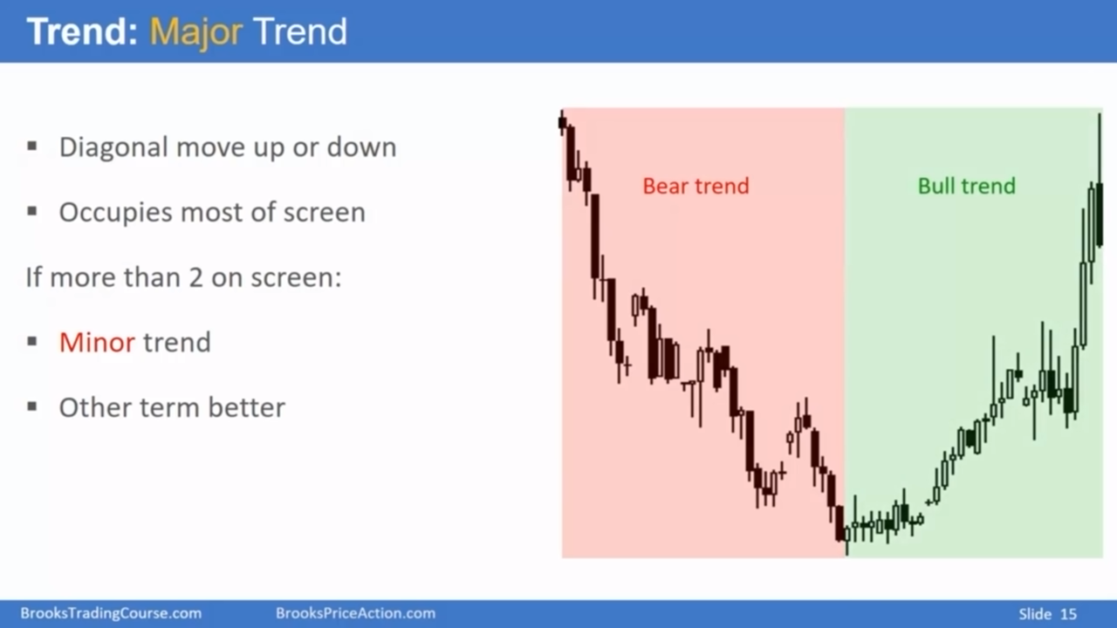

Slide 43
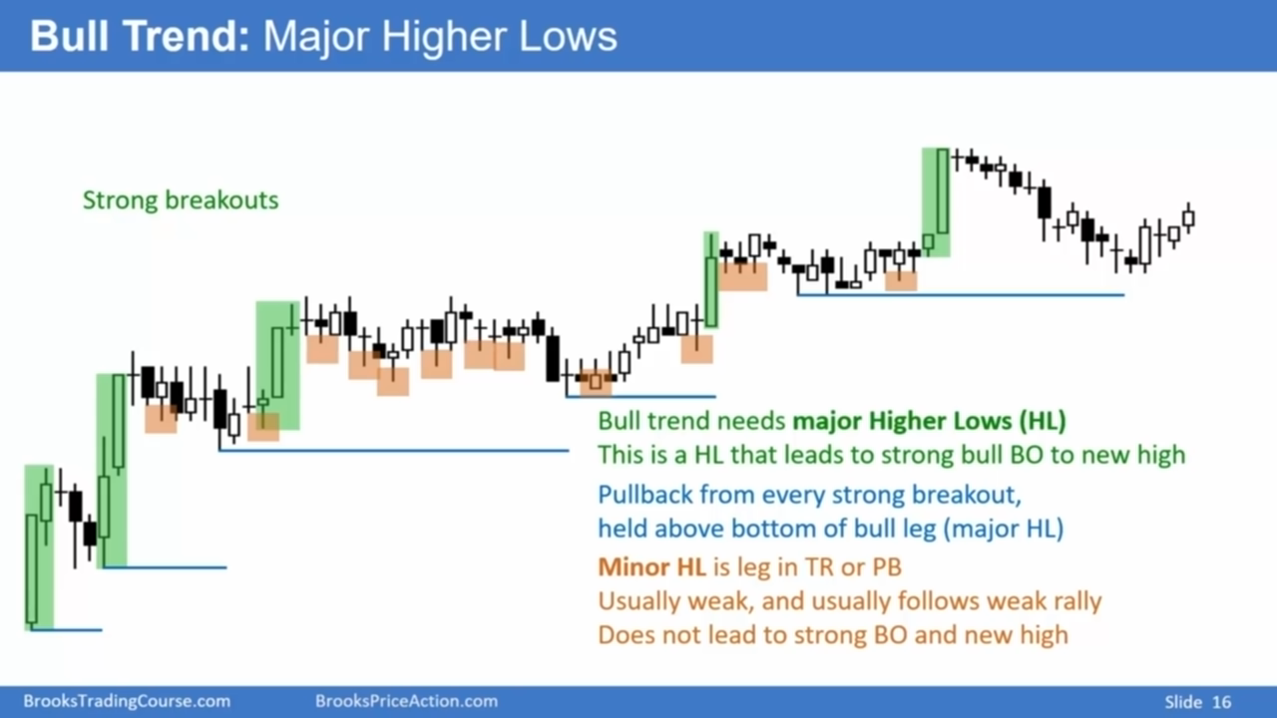
低点只要不低于前面BO的起点，那么我们认为趋势依然存在

Slide 44
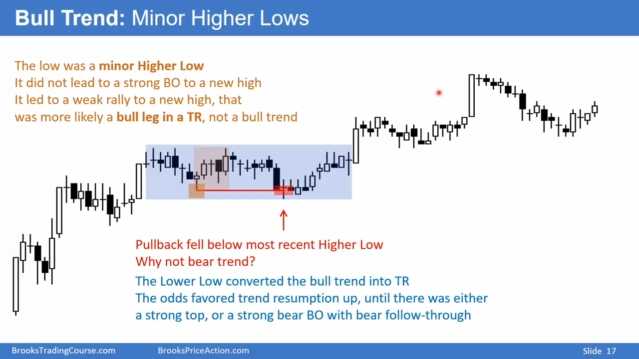

Slide 45
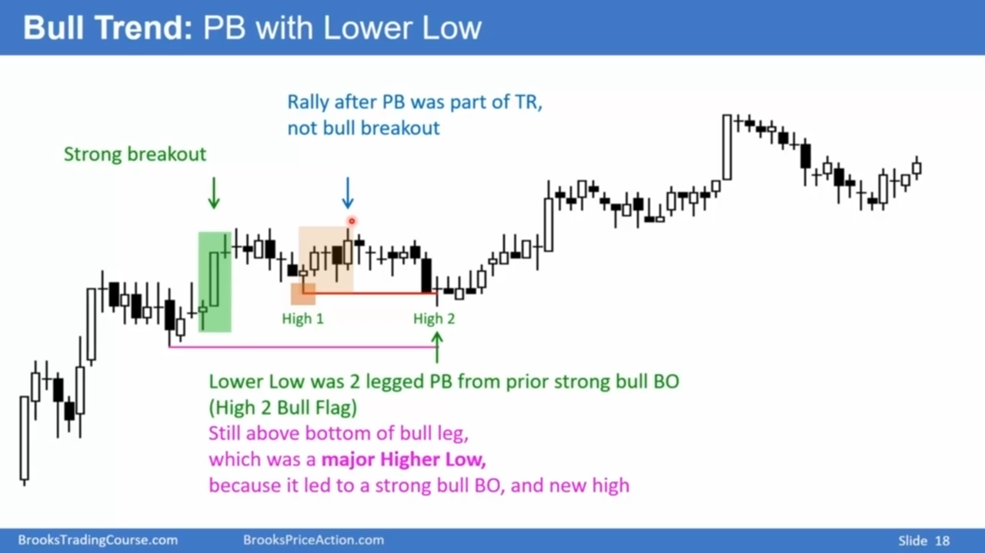

Slide 46
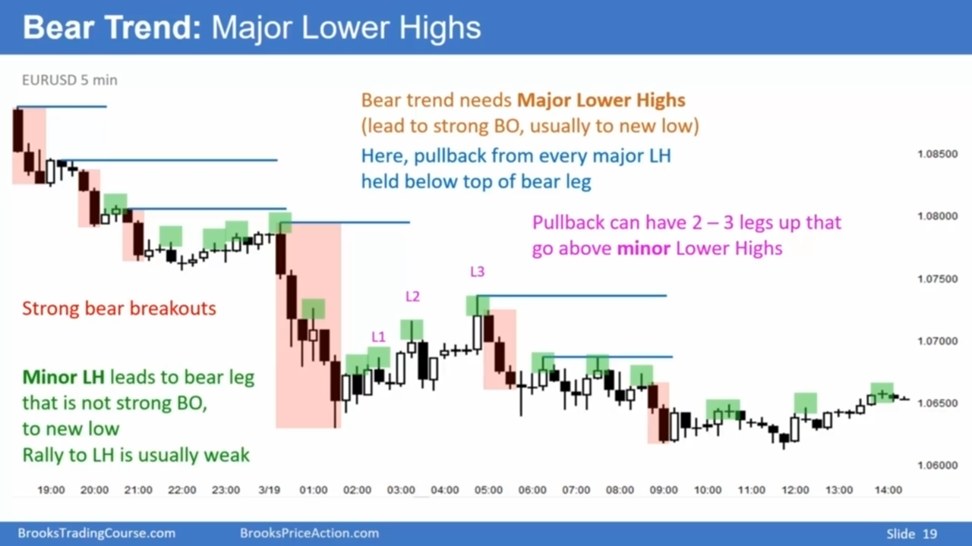

Slide 47
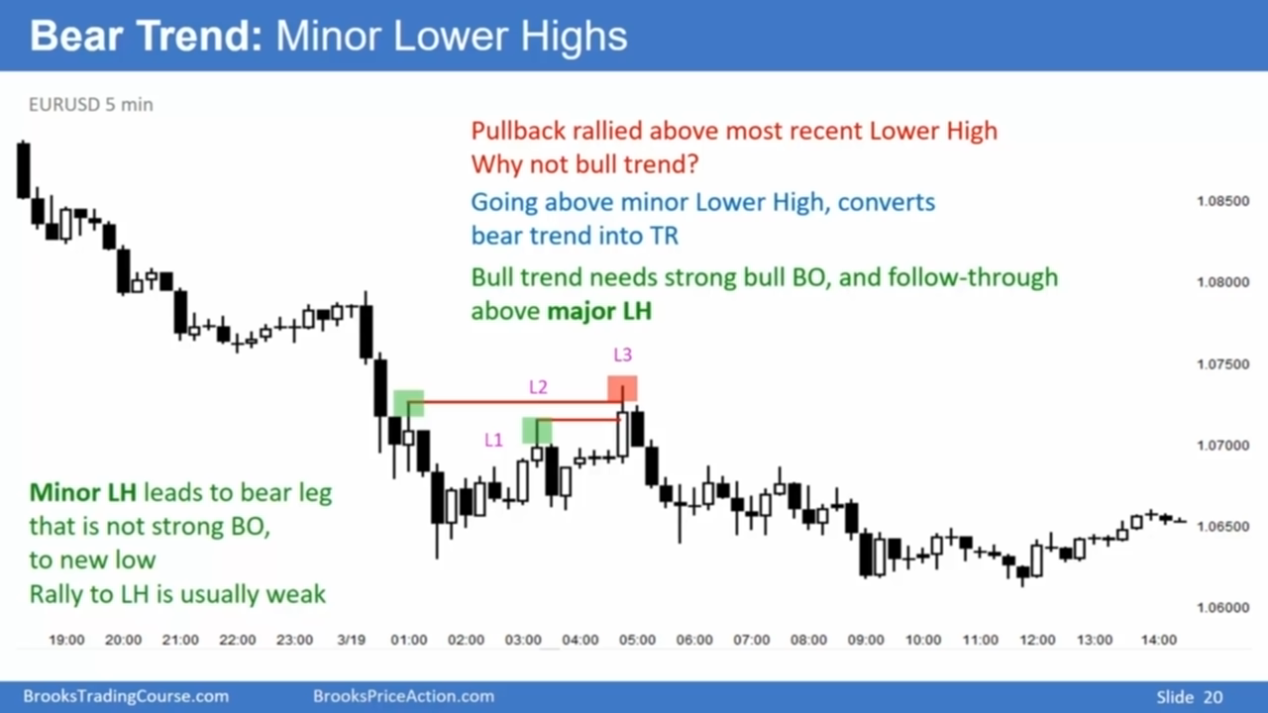

Slide 48
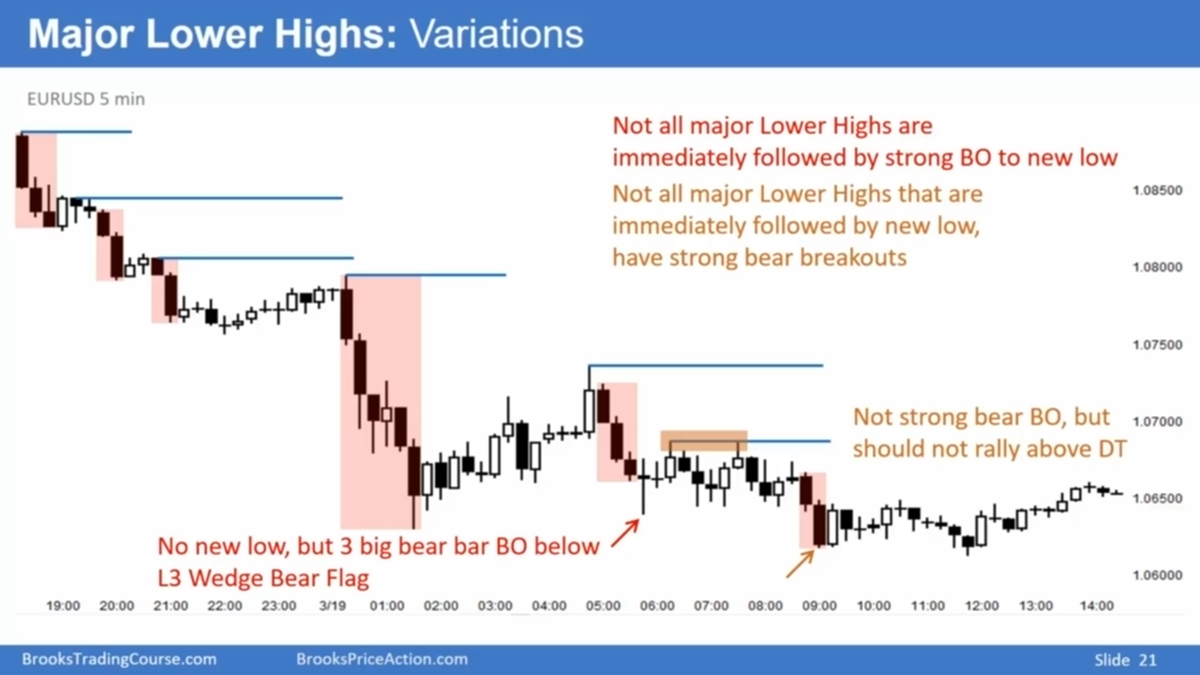

Slide 49


Slide 50


Slide 51


Slide 52


Slide 53

Notes:
In this video, I talked about the market cycle and how every chart is either in a trend or a trading range. Every part of every chart is either in a trend or a trading range. In fact, every bar is either a trend bar or a trading range bar.
And then I also talked about my 80% rule. Market has inertia tends to continue what it's been doing. It tends to resist change If it's in a trend 80% of reversal attempts will fail If it's in a trading range 80% of attempts to break out into a trend will fail
And then finally I talked about Any move up or down on a chart is a leg if the leg goes up far enough or down far enough for a swing trade I tend to call it a swing and And if there's clearly a strong trend breaking out far beyond the bars to the left, as long as there are only one or two such big swings on the chart, I tend to call them a trend. If there are three or more, I tend to call them swings and I tend to look at the chart as being in the trading range.

Slide 54


Slide 55


Slide 56


Slide 57


Slide 58


Slide 59


Slide 60


Slide 61


Slide 62


Slide 63


Slide 64


Slide 65


Slide 66


Slide 67


Slide 68


Slide 69


Slide 70


Slide 71


Slide 72


Slide 73


